Slide 1
Watershed segmentation on flow cytometry
20120627

Slide 2
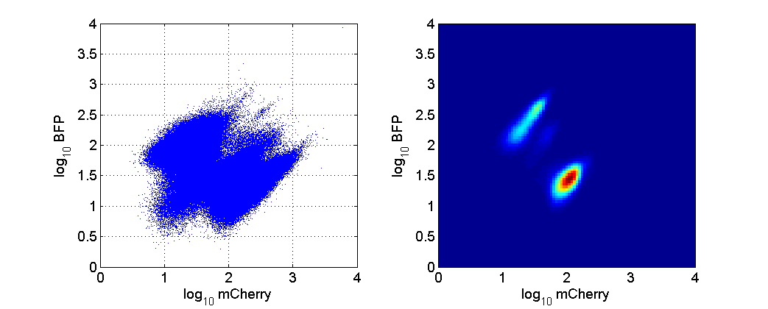
Test data
Experiment tgj22b Tube 15
No filter or gate
Bin data – 2d histogram

Slide 3
Invert and smooth
Peaks become troughs
Gaussian blur

Slide 4
“mark” peaks (arbitrary threshold) and background (zero)

Slide 5
Watershed segmentation

